Slide 1
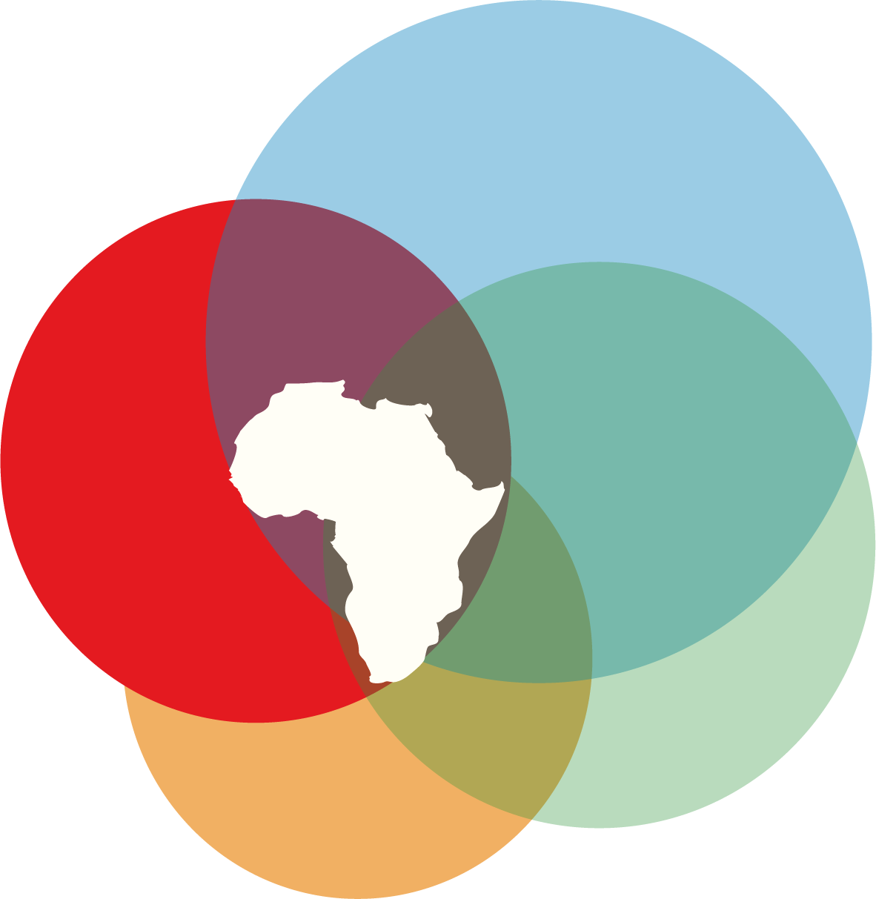
The WIPO GR-ATK Treaty
Disclosure of Source & (Databases) Info Systems – Technological Opportunism
Professor Chidi Oguamanam
Workshop on Reconciliation, Indigenous
Intellectual Property and UN Declaration Act
Moncton, NB, May 27-8, 2025

Slide 2
Road Map
Article 3, WIPO Treaty - Disclosure Requirement
Article 6, Information Systems
Why Dichotomy Around 3, 6
Technological Opportunism and its
Ramifications

Slide 3
Mandatory
Disclosure
Information
Systems
Complementarity
or Conflict
WIPO GR-ATK
TREATY

Slide 4
Article 3, WIPO-GR-ATK: Mandatory Disclosure (modified)
3.1 Where the claimed invention in a patent application is based on genetic resources, or traditional knowledge, each Contracting Party shall require applicants to disclose
a) the country of origin of the genetic resources or Indigenous Peoples or local communities who provided the traditional knowledge associated with genetic resources
b) in cases where the information in Article 3.1 (a) is not known to the applicant, or where Article 3.1(a) does not apply, the source of the genetic resources or source of traditional knowledge associated with genetic resources

Slide 5
Article 6, WIPO-GR-ATK: Information Systems (modified)
6.1 Contracting Parties may establish information systems (such as databases) of genetic resources and traditional knowledge associated with genetic resources, in consultation, where applicable, with Indigenous Peoples and local communities, and other stakeholders, taking into account their circumstances:
Appropriate Safeguards 6.2
Consultation with IPLCs 6.2
Info Accessible to Patent Offices for search + examination 6.2
Technical Working Groups on Information systems 6.3

Slide 6
Articles 3 and 6: Complementary and Conflict
Suspicion
Distrust
Disclosure of
Origin/Source
From Databases
To Information Systems
Rights-Based
Measures-Based
Burdensome on the Patent
System
Open-ended Possibilities for Digital Transformation

Slide 7
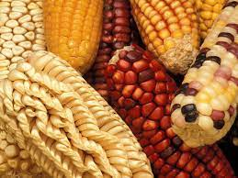
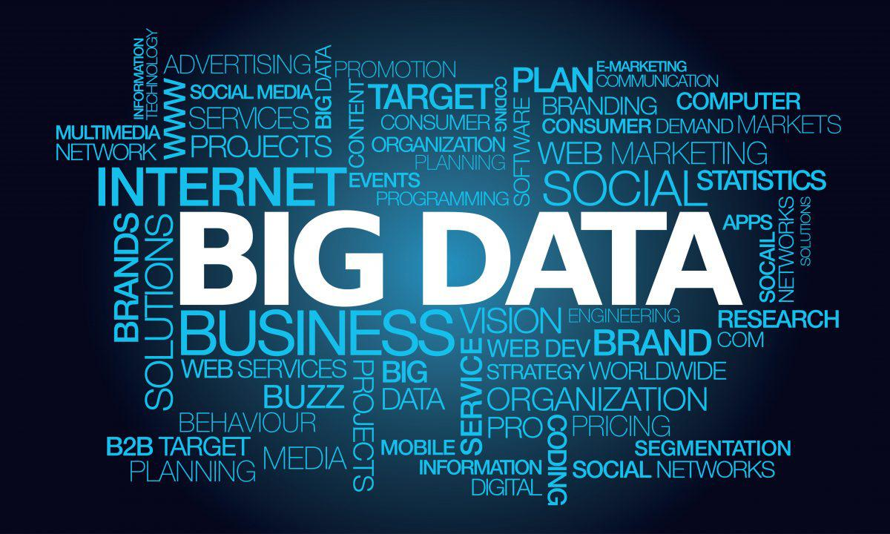
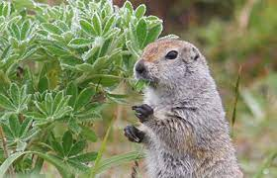
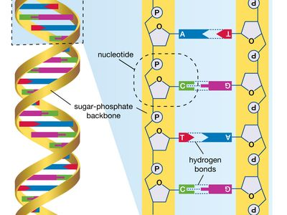

Slide 8
Information Systems: No Holds Barred
Preparedness, Capacity, Resources, Design, Legitimacy, Politics, Institutional Roles, etc.
Tiered Approach:
*Sacred/Secret
*Widely Diffused
*Narrowly Diffused
Datafication of TK
Digital
Sequencing
(Samples)
Digitization,
Inventorying. Databases
Machine
Leaning
Digital Divide
Tech Asymmetry
Internet Scrapping

Slide 9
ABS CANADA

