Slide 1
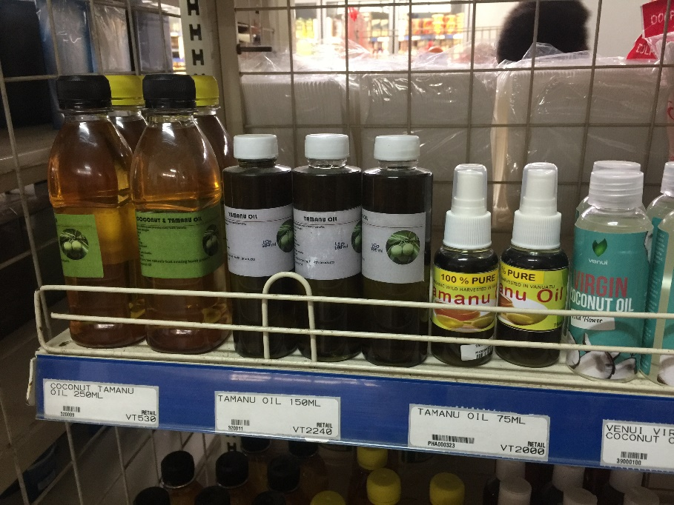
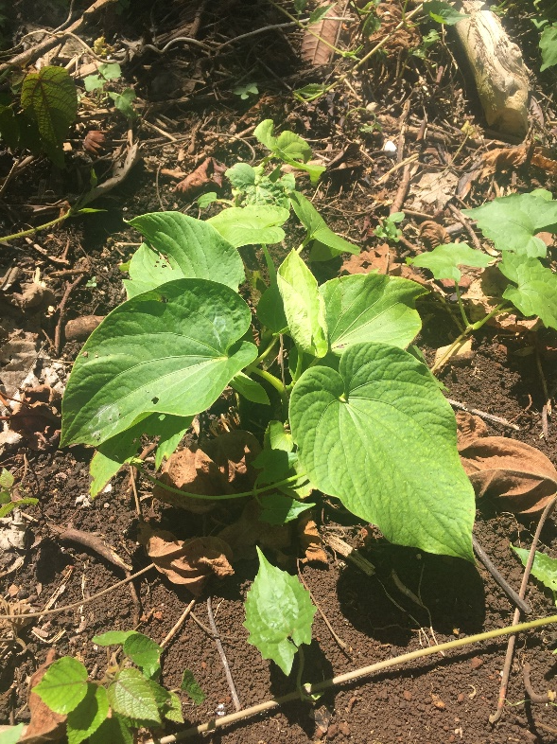
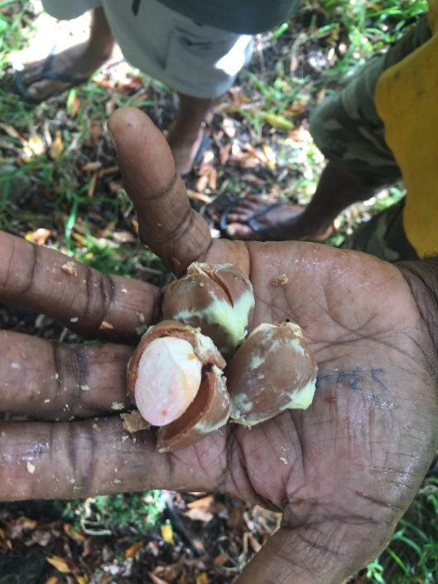


Indigenous Knowledge Futures: Supporting Indigenous People and Producers in the Region
Prof Daniel Robinson
A/Prof Miri (Margaret) Raven
Environment and Society, UNSW, Sydney

Slide 2
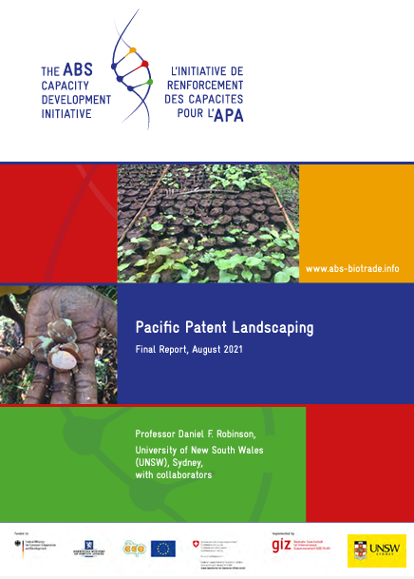
Projects: IK Futures and ABS Initiative
ARC Discovery: Indigenous knowledge futures. Protecting and Promoting IK (in Australia, Vanuatu and Cook Islands)
patent landscaping,
species case studies,
Patent challenges
biocultural protocol development.
Additional workshops and support for Indigenous businesses across 2-3 projects with DFAT and WIPO, ACIAR and WA Gov.

Slide 3

Nagoya Protocol to the
Convention on Biological Diversity (CBD)
Prior informed consent (PIC) and access and benefit-sharing (ABS)
Scope includes traditional knowledge
Relevant to bush foods & medicines research
Encourages recognition of customary laws and community protocols (Article 12)
141 ratifications (Australia is signatory)
The CBD COP 10 logo,
www.cbd.int , 14/3/2011

Slide 4
ABS Laws in Australia
Northern Territory Biological Resources Act (2006)
Commonwealth: Environmental Protection and Biodiversity Conservation Regs (2006) Part 8A.
Queensland Biodiscovery Act (2004, with 2020 amends and TK Code)
Western Australia Biodiversity Conservation Act (2016) and Regulations.
All have limited scope!
Australia has not implemented UNDRIP, has ‘Native Title’ laws for limited recognition of customary rights to land and resources.

Slide 5
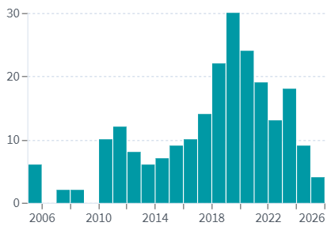
Patents on “Kakadu plum”
What are the Issues?
‘Kakadu plum’: 113 patents (of 51 patent families) – many are Mary Kay Inc.
‘Terminalia ferdinandiana’: 225 patents (of 90 patent families)
Many uses derived from knowledge of the plum as high energy food.
Trademark filings also for various uses of the name ‘Kakadu plum’
‘Kakadu Plum’ in Abstract, Title, Claims
Patent Lens, accessed 14/3/2025

Slide 6
Patent Mapping: Method Flow Chart
Filter records further and ID patents of interest
List plants from texts
Search patent records
(title abstract or claims)
Record country, applicant name, field etc.
Collate list of species endemic/near to country/sub-regions.
Patent Lens ‘structured’ search: analyse “species name” in patent title, abstract or claims.
Use ethnobotanical texts to examine likeness to TK.
Publications and ‘species of interest’ case studies.
Link: Patent Lens: www.lens.org
Notes:
narrow down the 202 families to a more manageable dataset
used the texts to identify which of the species were endemic or near endemic to New Zealand.

Slide 7
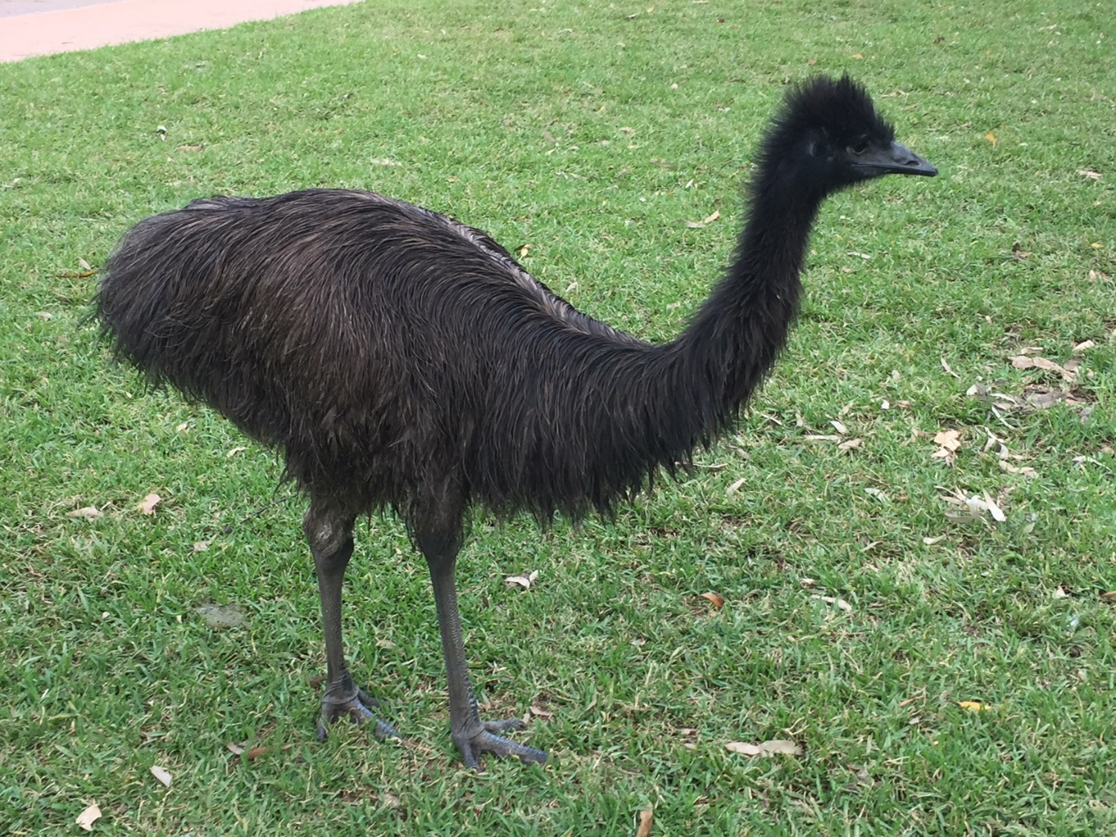
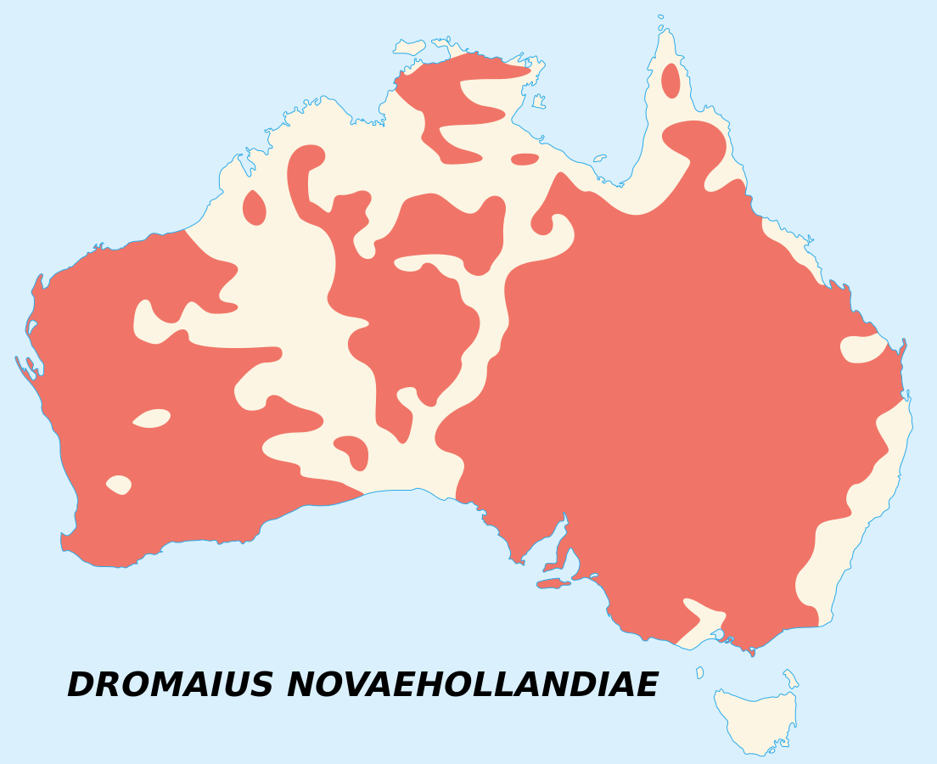
Let’s think about Emu:
Emu = Dromaius novaehollandiae
The emu is the second largest flightless bird by height after it’s ratite relative the ostrich.
It is endemic to Australia, and is our largest bird.
It is one of the two animals on the Australian Coat of Arms.
It features on Australian currency (e.g. the 50cent piece).
Sémhur / Wikimedia Commons / CC-BY-SA-3.0

Slide 8
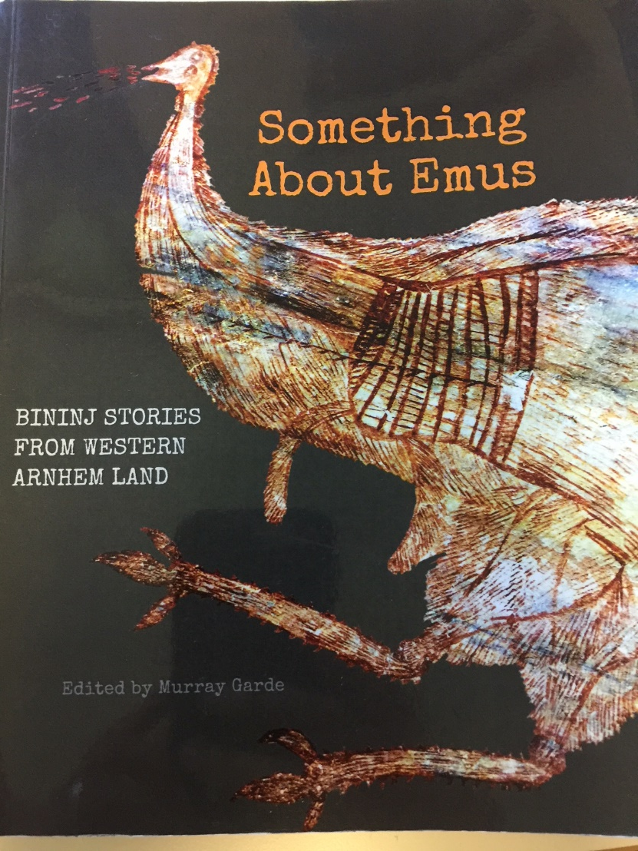
Something (Special) About Emus:
Emu is an iconic species featuring in Aboriginal People’s Dreamings.
Emu is a major feature of Aboriginal Astronomy.
Emu is a totemic or moiety species for some Indigenous Australian peoples and families: “In the Aboriginal Australian world view, animals are other kinds of people, and emu, perhaps more than most animals, is a special kind of person” (Garde, 2017, XV)
“In the Bininj Kunwok languages of Western Arnhem Land and Kakadu, Emu is described as ‘ngal-rongmiken’, which means ‘always turning from place to place, a bush traveler.’” (Garde, 2017, XV).
©. Murray Garde (2017) Something about Emus, Aboriginal Studies Press. (Fair Use).

Slide 9
R&D on Emu oil:
An Australian Government funded report by consultants for the Rural Industries Research and Development Corporation (RIRDC), authored by Snowden et al (1999), indicates:
Prior to the commencement of this study, the evidence for the efficacy of emu oil as an anti- inflammatory agent has been largely anecdotal, such as ‘Australian aboriginals have used emu oil for centuries to treat inflamed joints’. The first accounts of the efficacy of this oil were published in the mid 1800's. However recently, a wide range of therapeutic applications for the oil have been claimed in two United States patents. Unfortunately, no statistical evaluation of the results was presented in these patents.
Papers/reports de-valued the IK, but then used it anyway!

Slide 10
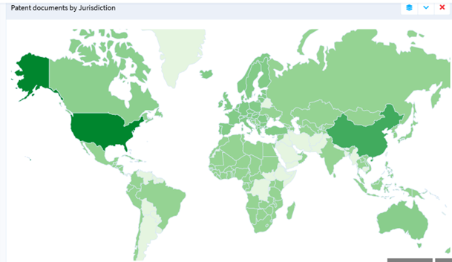
Emu oil patents
The Lens patent search results for “emu oil.” Accessed March 2025.
691 Patent Results from 383 patent families.
Mostly in the US, for skin care and arthritis, directly from Aboriginal knowledges.
Example: ‘pain relief’, such as US 2020/0163910 A1 (granted)

Slide 11
What about Emu?
The patent examples compartmentalize and claim Emu in limited claims (limited by time – 20 years, and space – by jurisdiction) monopoly rights. There are multiple reasons to be concerned about this, indeed from multiple perspectives.
What does it mean if one’s totem, one’s mother or one’s aunt is patented?
What does it mean if a symbol of one’s creation – the emu from people’s Dreamings – is held as a monopoly right?
Excluding ‘customary law’ rights associated with the use of emu oil by Aboriginal communities, negates Aboriginal peoples from benefiting from ongoing ancient traditions and economies underpinned by totemic relationships to the emu.
The act of overwriting ‘customary law’ for private property rights is an act of cultural destruction to which the impacts are yet to be measured.

Slide 12
Challenges for ABS in Australia:
Limited ABS laws and jurisdictional issues (e.g. no laws in NSW, southern states) as plants/animals move and are traded.
Who is the ‘provider’ of the genetic resources – typically landholder?
Challenges with Native Title and land councils as seen in NT and Qld – who is appropriate provider?
Who are the knowledge-holders and how are they represented?
In making ABS agreements, who is inside and who is left outside?
Can researchers ‘cherry-pick’ who they go to?
DSI or synthetic natural mimic circumvention of ‘access’ esp. in some sectors (e.g. pharma and biotech).
Time-lines don’t typically line up. Commercial imperatives drive speed of R&D demands.

Slide 13
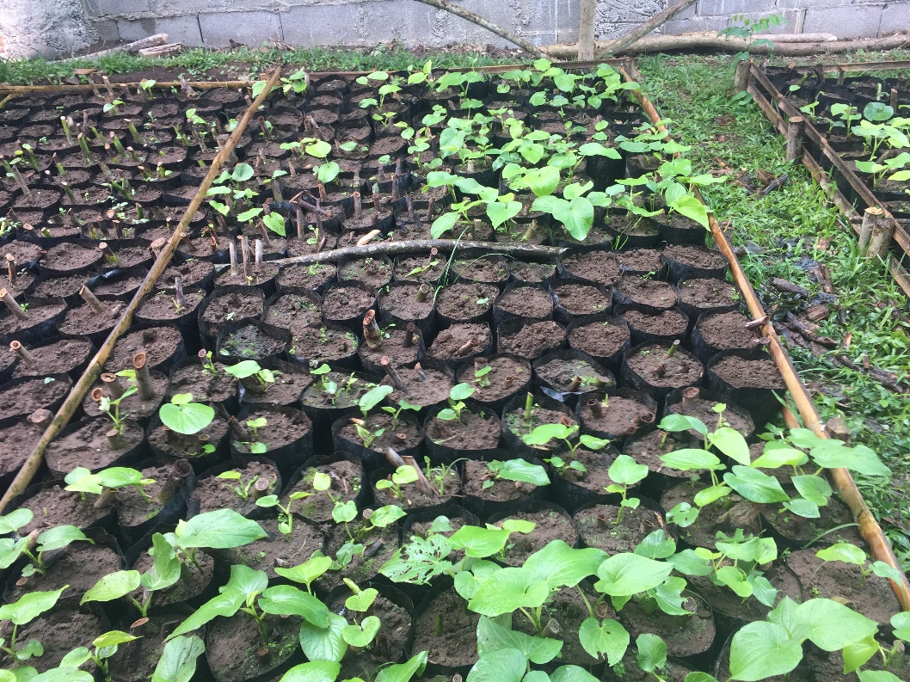
Kava (Piper methysticum)
Kava is culturally and economically important plant in Vanuatu and Pacific
Creation stories in Hawaii and Vanuatu
Used ceremonially in Vanuatu at the end of disputes/ traditional courts (nakamals).
Transformed in recent years into a ‘hipster’ drink traded and drunk in ‘bars’.

Slide 14
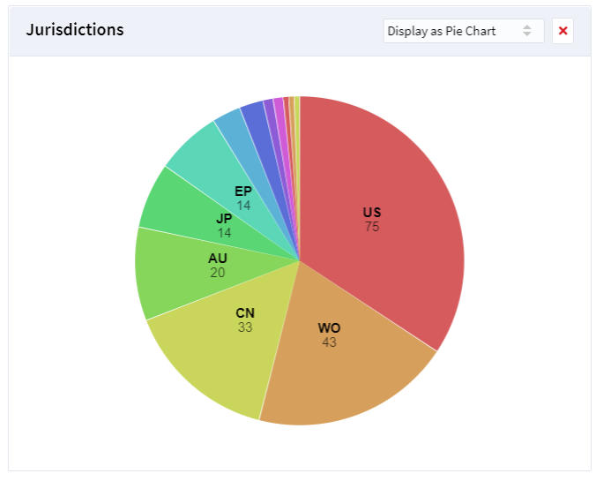
Kava: Patent Landscape
Kava = Piper methysticum
217 patent applications (139 families)
49 patents granted, 159 pending
Many patent uses: herbal supplements, plant extracts, medicines, methods and processes for turning into a powder/drink.
Some are very close to the TK uses: E.g. Pipermethystine-free Extract Of Piper Methysticum Useful For Treating Anxiety, Nervous Tension And Agitation
Lens.org, May 2023.

Slide 15

Aitutaki Community Protocol
Developed with Aitutaki traditional medicines and healers network
Was discussed in 2018-2019, then formalised in meetings in 2023 (post COVID interruptions)
Sets out rules for working with the network and for preserving, protecting and promoting traditional medicinal knowledge.

Slide 16
Traditional Knowledge Laws
Vanuatu Traditional Knowledge and Expressions of Culture Act (2020) – registration of TK and CEs by kastom-owners.
  Kastom boundary mapping (cultural mapping) of 78 boundary areas in 80+ islands needed.
  Recognise customary laws/rights and minimise state presence.
Cook Islands Traditional Knowledge Act (2013)
Intellectual Property Australia consultation: disclosure of origin, IK law, Indigenous IP advisory panels

Slide 17
Things we can do together
Challenge concerning patents and trademarks
Improve ABS laws and ‘fill in the gaps’
ABS contracts and point of sale contract clauses
Point-of-sale/ market protocols
Biocultural protocols
Intellectual property reforms: patent and trademark advisory committees, disclosure of origin
Improve local producer value addition in value chains
First Nations certification marks
Indigenous knowledge exchanges in the region!

Slide 18
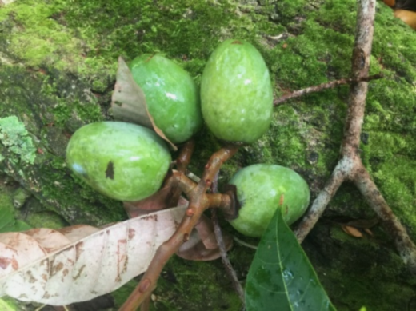
Open to collaboration
& supporting local initiatives
Thanks to Mr Retire Puapii, Donna Kalfatak, Trinison Tari, John Huri, Mimosa Bethel, Dr Hai-Yuean Tualima, Lyb Makin, Rahul Chand, Amanda Wheatley, Juney Ward and the SPREP Team, Repeta Puna, and all our local collaborators.

Slide 19
References:
Chand, R., Robinson, D.F. and Drews, A. (2022) The Nagoya Protocol on ABS. Lessons from the Pacific, SPREP, Apia and ABS Initiative, Eschbonn.
Lens.org, multiple searches and images, used with permission.
Raven, M., Robinson, D., & Hunter, J. (2021). The Emu: More‐Than‐Human and More‐Than‐Animal Geographies. Antipode, 53(5), 1526-1545.
Raven, M., & Robinson, D. (2022). ‘Biocultural Rights and Protocols in the Pacific’. In Girard, F., Frison, C., & Hall, I.(eds) Biocultural Rights, Indigenous Peoples And Local Communities, Routledge. pp.203-220, Ch8.
Robinson, D., Raven, M., Makin, E., Kalfatak, D., Hickey, F., & Tari, T. (2021). Legal geographies of kava, kastom and indigenous knowledge: Next steps under the Nagoya Protocol. Geoforum, 118, 169-179.
Robinson, D. and collaborators (2022) Pacific Patent Landscaping and Biotrade, ABS Initiative, Eschbonn, Germany.
Robinson DF; Raven M, 2020, 'Recognising Indigenous customary law of totemic plant species: Challenges and pathways', Geographical Journal, http://dx.doi.org/10.1111/geoj.12320

Slide 20
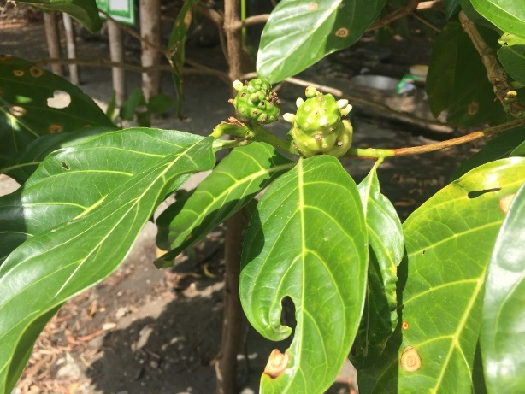
References:
Lens.org: Patent data used and cited with permission – multiple dates
Lindstrom, L. (2009) ‘Kava Pirates in Vanuatu?’ International Journal of Cultural Property, Volume 16, Issue 3, pp. 291-308
Robinson, D.F. (2015) Biodiversity, Access and Benefit-Sharing: Global Case Studies, Routledge, Oxon.
Robinson, D.F. and Raven, M. (2017) ‘Identifying and Preventing Biopiracy in Australia: Patent trends for plants with Aboriginal uses’, Australian Geographer, 48:3, 311-331
Nagoya Protocol on Access to Genetic Resources and the Fair and Equitable Sharing of Benefits Arising from their Utilization to the Convention on Biological Diversity (2010): https://www.cbd.int/abs/text/
Winter, K. (2004) Hawai’ian `Awa Piper methysticum. A study in ethnobotany. MSc Thesis, University of Hawai’i.

Slide 21

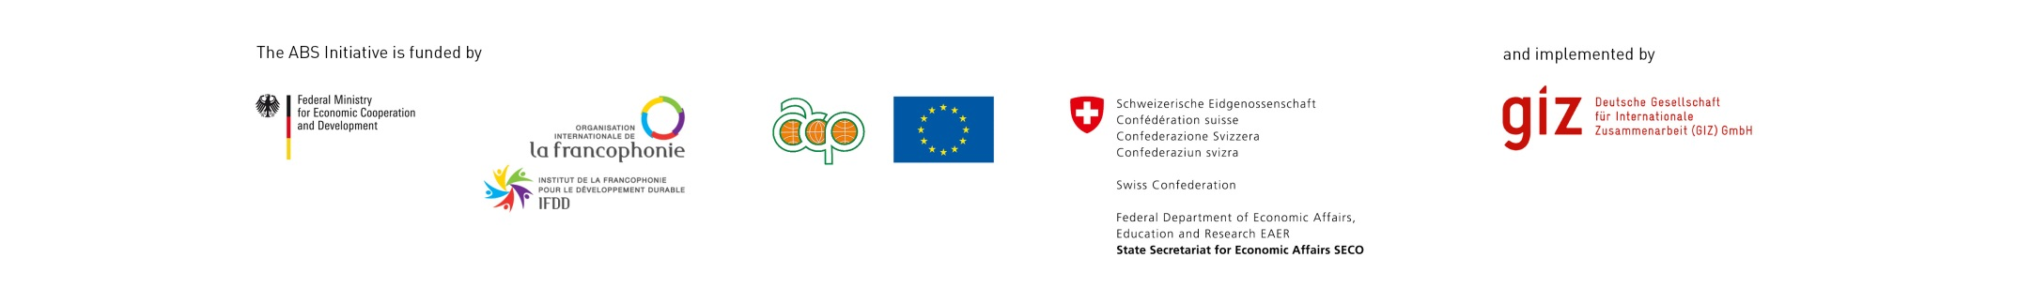
Sources for Further information
UNSW basic project profile and paper links: https://research.unsw.edu.au/people/professor-daniel-robinson
ABS Initiative papers, links and explanation of the Pacific regional project (2018-2022):
http://www.abs-initiative.info/

