Slide 1
Access and benefit-sharing (ABS): Overview and Government of Canada approaches
MAPC workshop on Indigenous Intellectual Property
May 2025
Kate Davis
International Biodiversity Policy
Canadian Wildlife Service, ECCC
Kathryn.davis@ec.gc.ca

Slide 2

Contents
Access and Benefit-Sharing (ABS) overview
Government of Canada and ABS (pre-2022)
Government of Canada and ABS/DSI (post-2022)
New issue: “Digital sequence information on genetic resources” (DSI)
ABS in Canada’s 2030 Nature Strategy

Slide 3






1992 Convention on Biological Diversity (CBD)
3 Objectives:
  Conservation of biological diversity
  Sustainable use of its components
  Fair and equitable sharing of the benefits arising from the utilization of genetic resources including by appropriate access to genetic resources and by appropriate transfer of technologies, taking into account all rights over those resources and to technologies, and by appropriate funding
Countries have sovereign rights over their own biological resources, and decide how their “genetic resources” should be accessed by users…
National government
Providers
PIC
MAT
Biodiversity
Access to genetic resources and Benefit-Sharing (ABS) defaults in CBD:
Prior Informed Consent (PIC) from the provider country
Mutually Agreed Terms (MAT) between provider & user for use and benefit-sharing
benefit-sharing
ABS
Users
Rights
Sovereign rights, Indigenous rights, Intellectual Property Rights, property rights, human rights
Technology

Slide 4
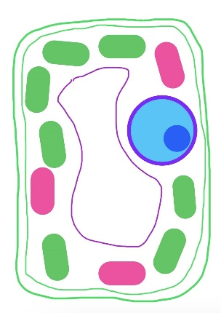



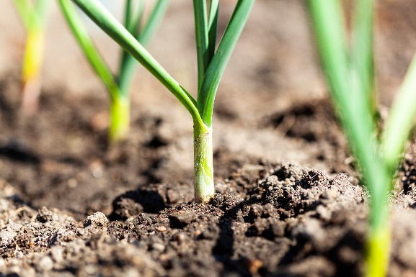




What are genetic resources?
CBD definition : any material of plant, animal, microbial or other origin containing functional units of heredity, of actual or potential value
utilization
Organisms contain cells, containing DNA (and/or RNA), encoding instructions for life’s building blocks
In practice, physical stuff containing DNA or RNA
Genetic resources can be ‘utilized’ for basic research and many different commercial applications
Benefit-sharing can take many forms, ‘non-monetary’ and/or ‘monetary’
  knowledge and opportunity sharing, capacity-building, technology transfer, access fees, royalties…

Slide 5
ABS in the CBD, 1992-2021
3rd Objective: Fair and equitable sharing of the benefits arising out of the utilization of genetic resources, …
Article 15: Sovereign rights, facilitate access, prior informed consent, mutually agreed terms, measures to ensure benefit-sharing
  + Articles 8j (benefit-sharing for TK), 16 (technology transfer), 19 (benefits from biotechnology)
2010 Nagoya Protocol on ABS (Canada is not a Party) adds on:
  Access process + Benefit-sharing examples + Compliance measures
  Traditional Knowledge associated with genetic resources;
  national authorities and ABS Clearing House;
  voluntary measures; community protocols; capacity building; etc.
  intellectual property in context of examples of benefit-sharing; no "DSI"

Slide 6
GoC action on ABS in Canada (Pre-COP15)
Years | ABS and DSI work
2004-07 | Domestic work, stakeholder & Indigenous workshops and Federal-Provincial- Territorial Ministers' ABS Policies in Canada: Scoping the Questions and Issues towards a coherent Canadian approach with consistent measures
2008-09 | Consultations on domestic policy and negotiating mandate for “international instrument” on ABS
2010 | Nagoya Protocol on ABS (NP) on ABS adopted at 10th Conference of the Parties to the Convention on Biological Diversity (COP10)
2010-11 | Discussions with federal departments, provinces and territories, Indigenous Peoples and stakeholders on draft domestic policy and draft NP
2012 | NP not signed; ECCC instructed to further develop Canada’s domestic policy
2012-16 | Discussions on federal ABS policy, further engagement with provinces and territories, Indigenous Peoples and stakeholders
2017- Nov 22 | GoC focus shifts to international ABS issues - Digital Sequence Information on Genetic Resources (DSI) & post-2020 Global Biodiversity Framework

Slide 7
GoC action on ABS in Canada (COP15 onwards)
Years | ABS and DSI work
Dec. 2022 | COP15 Decisions on DSI and on Kunming-Montreal Global Biodiversity Framework (KMGBF Goal C, Target 13)
2023 | Outreach to Indigenous representatives and for Canadian DSI position & Target 13 Implementation Plan for Canada’s 2030 Nature Strategy
2024 | COP16 Decision operationalizing DSI multilateral mechanism and Cali Fund
2025 | Drafting report on Canadian actions to implement KMGBF
2026 | 7th National Report to CBD…
2026-29 | Actions towards 8th National Report to CBD…

Slide 8

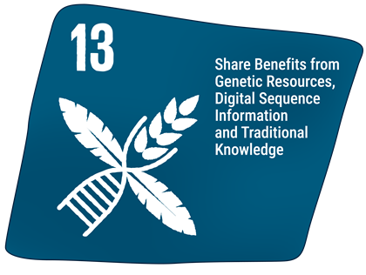
KMGBF Goal C and Target 13
Goal C: Share benefits fairly
The monetary and non-monetary benefits from the utilization of genetic resources and digital sequence information on genetic resources, and of traditional knowledge associated with genetic resources, as applicable, are shared fairly and equitably, including, as appropriate with indigenous peoples and local communities, and substantially increased by 2050, while ensuring traditional knowledge associated with genetic resources is appropriately protected, thereby contributing to the conservation and sustainable use of biodiversity, in accordance with internationally agreed access and benefit-sharing instruments.
Target 13: Increase the sharing of benefits from genetic resources, digital sequence information and traditional knowledge
Take effective legal, policy, administrative and capacity-building measures at all levels, as appropriate, to ensure the fair and equitable sharing of benefits that arise from the utilization of genetic resources and from digital sequence information on genetic resources, as well as traditional knowledge associated with genetic resources, and facilitating appropriate access to genetic resources, and by 2030 facilitating a significant increase of the benefits shared, in accordance with applicable international access and benefit-sharing instruments.

Slide 9

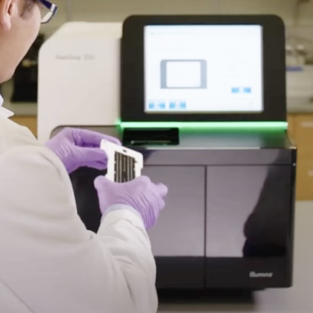
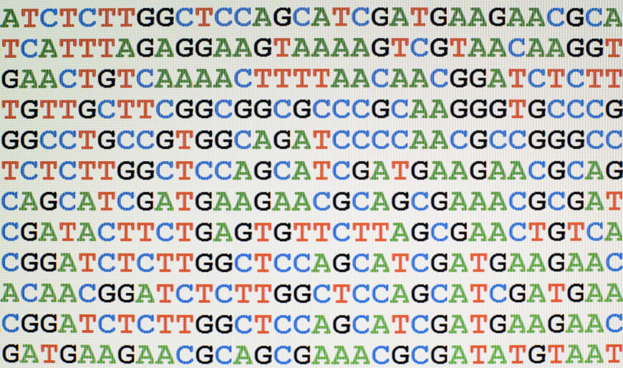

What is DSI?*
*no agreed definition!
DNA – made of string of coding units (A, C, G, T) whose order spells out instructions for life
Sequence data
Source: https://www.illumina.com/systems/sequencing-platforms/nextseq.html/
storing & sharing
sequencing
DSI
Source: https://blogs.technet.microsoft.com/
This Photo by Unknown Author is licensed under CC BY-NC
When DNA and RNA are sequenced, the order of coding units (sequence data) can be stored digitally
Such “digital sequence information on genetic resources” can be submitted to international public databases, allowing DSI from around the world to be compared in the millions, analyzed and used
DSI is easier to access than physical genetic resources…

Slide 10
DSI + benefit-sharing issue in CBD
CBD default: Access with prior informed consent (PIC) of the provider country, under mutually agreed terms (MAT) between provider and user, including provisions for benefit-sharing. Many countries have developed ABS laws in response to CBD and Nagoya
2016: African Group expressed concerns about growing use of data/information replacing the need to access a physical genetic resource, bypassing existing ABS laws and benefit-sharing.
Some countries started to extend ABS laws to cover such ‘DSI’ – but DSI is different…
DSI benefit-sharing discussions began in CBD, linked to negotiations of Kunming-Montreal Global Biodiversity Framework (KMGBF)
CBD COP15 in 2022:
  Benefits from DSI use should be shared in a fair and equitable manner
  DSI + benefit-sharing in the KMGBF (Target 13)
  Adopted a multilateral mechanism for DSI benefit-sharing, including a global fund

Slide 11
DSI negotiations 2022-2024
At COP15, Parties agreed…
  A DSI solution should: be efficient, feasible and practical; generate more benefits than costs; be effective; provide certainty and legal clarity for providers and users; not hinder research and innovation; be consistent with open access to data; be mutually supportive of other ABS instruments; take into account rights of IPLCs including on TK; benefits to support conservation and sustainable use and benefit IPLCs
  Multilateral mechanism: to avoid tracking DSI use and tracing origin of genetic resources (PIC and MAT are difficult for DSI; DSI with many origins accessed in large quantities)
  To be finalized at the 16th Conference of the Parties to the CBD in 2024
Key issues for the mechanism: ‘money in’, ‘money out’, non-monetary benefit-sharing & capacity-building, fund governance, data governance, relationship with national laws and international treaties

Slide 12

New mechanism: key elements
‘MONEY IN’
    Large commercial users from list of DSI-using sectors expected to pay 1% of profits or 0.1% turnover into Cali Fund
    Parties to take measures to ‘incentivize contributions’
  NON-MONETARY BENEFIT-SHARING
    All users of DSI should share non-monetary benefits, as appropriate

Slide 13
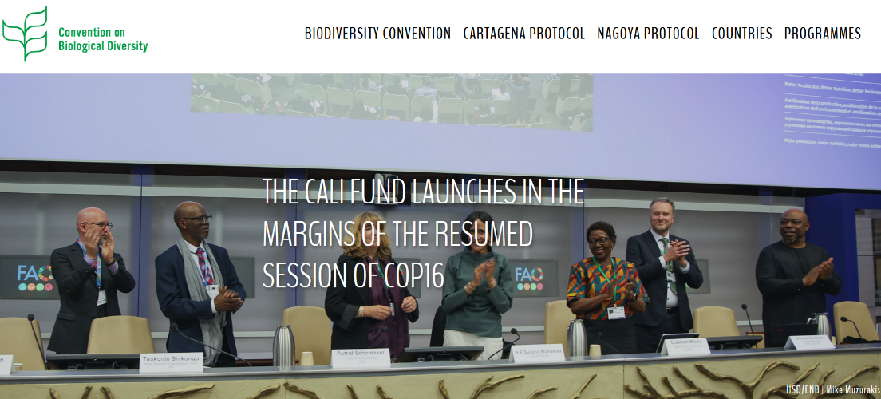
New mechanism: key elements
  DATABASES
  Databases to raise awareness of mechanism and flag responsibilities for data submitters and users, collect info about DSI sources (and if traditional knowledge used), consider FAIR, CARE, TRUST principles, flag that users need to indicate that DSI is not subject to restrictions on its sharing
    ‘MONEY OUT’
  To support CBD objectives in developing countries; benefit IPLCs; DSI capacity-building
  Cali Fund, hosted outside Global Environment Facility, with direct allocation to countries
  >1/2 of global funding to support IPLCs’ self-identified needs
Cali Fund launched 25 Feb 2025
IISD/ENB | Mike Muzurakis

Slide 14
Decision 16/2 implications for Canada
Government of Canada:
incentivize contributions from large commercial users
ensure databases take actions
continue to push for Indigenous Peoples in developed countries as beneficiaries
…raise awareness for all users and providers
DSI databases in Canada:
provide information on DSI mechanism, signal ABS laws may apply
require information on country of origin and (where appropriate) TK use
consider data governance principles
Canadian DSI submitters and users:
Share non-monetary benefits (e.g. capacity-building to generate, access, use, store DSI)
know applicable national ABS measures;
know terms of use of genetic resources before sequencing/uploading
share info on country of origin and whether TK was used
Opportunities to flag benefit-sharing needs and actions on clearing-house (in future)
Indigenous Peoples in Canada:
Data governance: how to guide application of CARE Principles
Mutually agreed terms - can DSI be sequenced? Can DSI be shared publicly?
Community protocols - clarity on DSI?
How can/should use of TK be flagged in DSI databases?
Opportunities to flag benefit-sharing needs and actions on clearing-house (in future)
What entities are necessary/appropriate to receive funds from Cali Fund?
Input to Indigenous representatives on Cali Fund Steering Committee

Slide 15
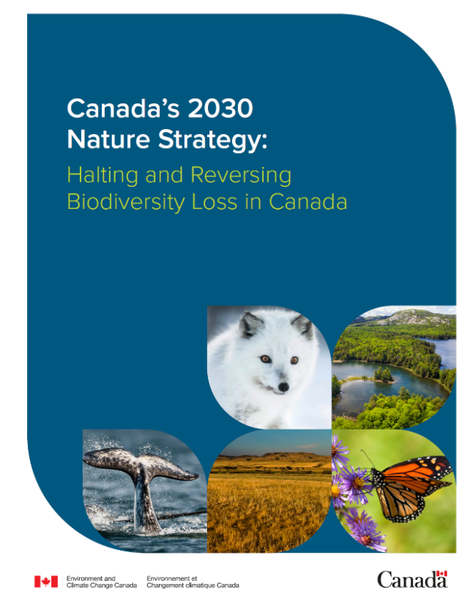
Target 13 in Canada’s 2030 Nature Strategy
‘What we’re doing’ (specific existing federal actions)
  Engaging in international efforts related to access and benefit-sharing (ABS);
  Maintaining ex situ collections;
  Undertaking genomic surveillance
‘Going further’ (possible actions - for 2026 National Report? 2029 NR?)
  Providing greater clarity to users and providers of genetic resources, sharing best practices for ABS, and identifying and assessing additional measures that could allow Canada to become a Party to the Nagoya Protocol
  Developing guidance on research and commercial bioprospecting
  Enabling users of genetic resources and associated Indigenous Knowledge to share information on benefit-sharing and compliance actions to measure progress toward domestic and global targets

Slide 16
Links
Decision 16/2 - Digital sequence information on genetic resources
COP15 Decisions: Dec. 15/9 (DSI), Dec. 15/4 (Kunming-Montreal Global Biodiversity Framework)
General DSI resources
DSI Resources (on CBD website: huge range of DSI studies, papers, reports, briefs – not curated)
Indigenous Peoples and DSI a set of resources for Indigenous Peoples
ABS Initiative DSI resources, including…
  DSI Simply Explained: 5 minute video produced by the ABS Capacity Development Initiative

