Slide 1
The Protection of Indigenous Knowledge and Cultural Expressions in Canada.
Meika Ellis – pillar IP
*Background image is of a pair of Auntie Eileen’s moccasins

Slide 2
1. Protecting IK/TK&CE through Canadian IP regimes
2. Constitutionally protected Aboriginal and Treaty rights
3. IP Profession’s response to WIPO IGC Treaty
4. Alternative approaches to protect IK/TK&CE

Slide 3
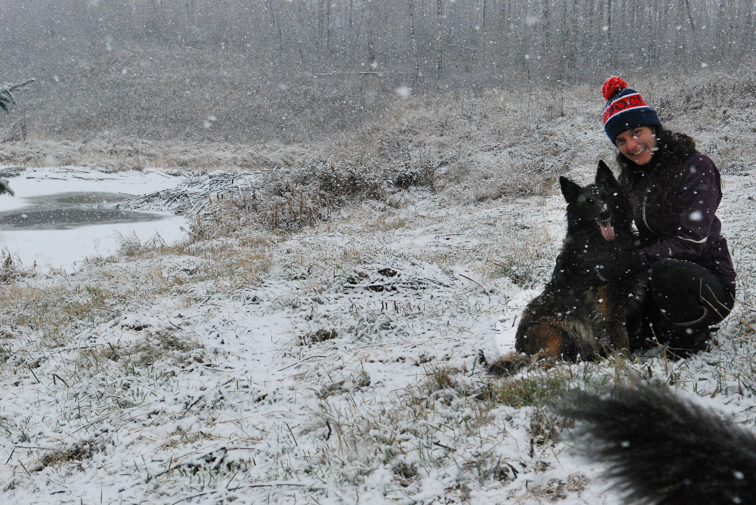
But first, a brief introduction
Notes:
I am a member of the Gwich’in Fort McPherson Band. I grew up outside of the community in the 90s and early 2000s just before Reconciliation became a buzz word. My mother is Gwich’in, and my father is a settler. I am on my journey to reconnect, understand, and learn about my Gwich’in community, and others. Since becoming an intellectual property law lawyer in 2018, I have strived and continue to strive to use my privileged position to shift how the Canadian IP profession treats IK/TK and CE and advocate for acknowledging and respecting Indigenous laws and practices that have evolved since time immemorial.

Slide 4
1. Protecting IK/TK&CE through Canadian IP regimes

Slide 5
a trademark
Protects goods and services of one business from another. It acts as a source identifier.
a patent
protects novel and original inventions
a copyright
protects original, fixed works (literary, artistic, sound recording, performance) that have clear authors
an industrial design
Protects the appearance of a product that is produced in quantity of 50+

Slide 6
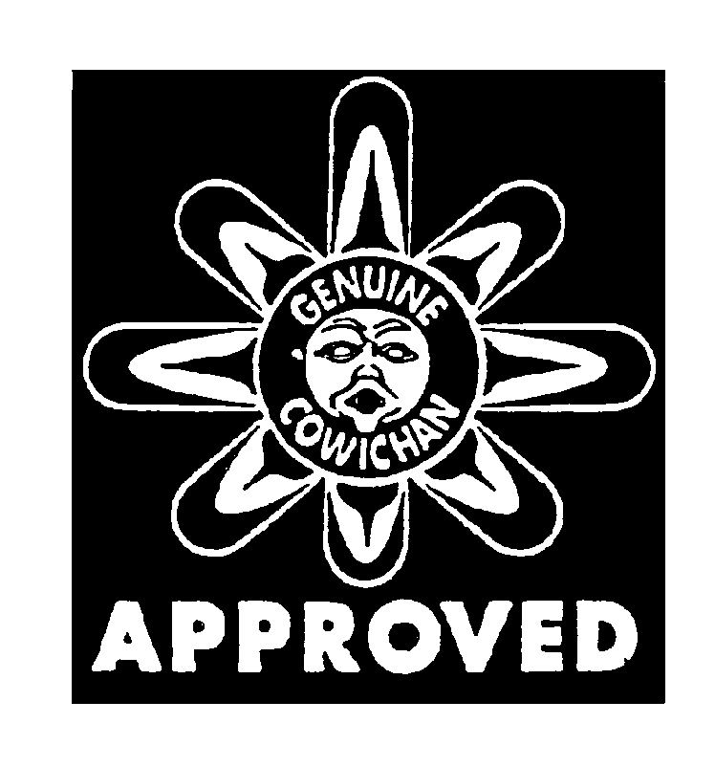
If it fits.
Is it collective or individual right? (CR, P, TM)
Is the knowledge or expression from generations ago or new? (P, PBR, ID)
Is the expression fixed? (CR)
Is the expression a style? (CR)
Is the symbol used in normal course of commercial trade? (TM)
Is it actually in the public domain or is it just publicly available? (P, ID, CR, TM)

Slide 7
2. Constitutionally protected Aboriginal and Treaty rights

Slide 8
“The existing aboriginal and treaty rights of the aboriginal peoples of Canada are hereby recognized and affirmed”
Constitution Act, 1982 (pt. II, s. 35(1))

Slide 9
Aboriginal rights are in part defined based on the “Aboriginal perspective”, meaning the Aboriginal rights holders’ customs, practices, traditions, and laws (Tsilhqot’in, para 34).
Tsilhqot’in Nation v British Columbia, 2014 SCC 44

Slide 10
Legislation, like the Copyright Act, Trademarks Act and Patents Act must be consistent with Canada’s Constitution including Aboriginal and Treaty rights
(Marie Battiste and Sa’ke’j Youngblood Henderson)
Maliseet tapes example shows that’s not the case
Image: The Aquinian, Shaw Goff, Feb 21, 2017, online: https://theaquinian.net/prof-upholds-maliseet-stories-language-new-book/

Slide 11
3. IP Profession’s response to WIPO IGC Treaty

Slide 12
https://www.wipo.int/edocs/mdocs/tk/en/gratk_dc/gratk_dc_3.pdf

Slide 13
4. Alternative approaches to protect IK/TK&CE

Slide 14
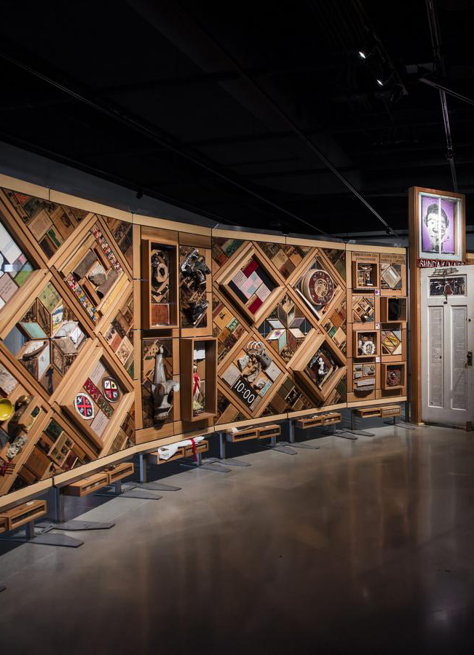
Tailored Agreements and the Witness Blanket
Image: CMHR, Jessica Sigurdson (online: https://humanrights.ca/exhibition/the-witness-blanket)

Slide 15
Sample of Brilliant Indigenous Legal Minds in Canada
Merle Alexander, MillerTiterle + Co (Indigenous resource law; empowering Nations through title and rights affirmation, sustainable economic development, and environmental conservation)
Sara Mainville, JFK Law (works within Indigenous legal orders on Self-government/determination, advancing treaty implementation, law making within Indigenous legal orders, Indigenous IP/Copyright)
Scott Robertson, Nahwegahbow Corbiere (Certified specialist on Indigenous legal issues)
Stuart Wuttke, Assembly of First Nations (Advancing First Nations Inherent and Treaty Rights)
Shoshanna Paul, Thompson Dorfman Sweatman (Aboriginal, labour, and employment, and IP law)
Bruce McIvor, First Peoples Law Corporation (Metis lawyer and historian, author, leading practitioner of Aboriginal law in Canada

Slide 16
Mahsi Choo / Thank you! Questions?
Meika Ellis (meika@pillarip.com)
*Background image is of a pair of Auntie Eileen’s moccasins

