Slide 1
Cali Fund and the Multilateral Benefit Sharing Mechanism
IIFB WG on DSI, 5/26/2025
Reconciliation and the United Nations Declaration Act: Indigenous Intellectual Property in Canada and International Developments
Presented from Geneva, Switzerland

Slide 2
It is (relatively) easy to divide bodies of animals and plants

Slide 3

BIOPIRACY
GRs
IPLC Territory

Slide 4

Main case of CBD & Nagoya Protocol
(post 1993 and 2014)
$$$$
IPLCs
Corporate
research
Biological
sample
Relations
Institutional research
Non-IPLCs
contains GRs
University research
Resources

Slide 5





Main relationship of GRs “and associated traditional knowledge”
TK as a lead to useful gene-influenced traits

Slide 6
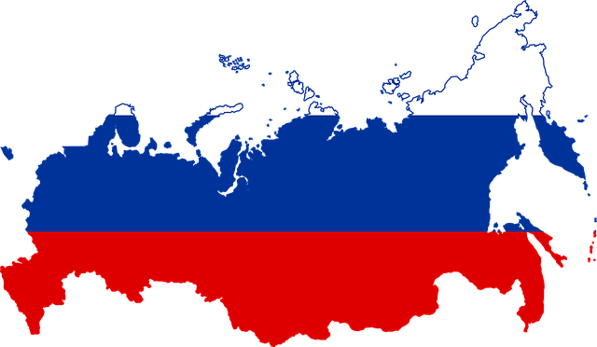
Article 10 of the NP identified the transboundary problem of the model
GRATK shared across
national borders
Bilateral, contract approach and (F)PIC
not possible
“Race to the bottom”
MLBSM proposed to share benefits fairly for all
Loss of access control
Identified conservation
benefits

Slide 7
4 base pairs of nucleotides
DNA:
A adenine
U uracil
C cytosine
G guanine
RNA: thymine substituted for uracil
Amino acid functional groups arranged into 23 standard aminos
Many complex patterns emerge from repetition of a smaller range of DNA/RNA patterns forming amino acids

Slide 8
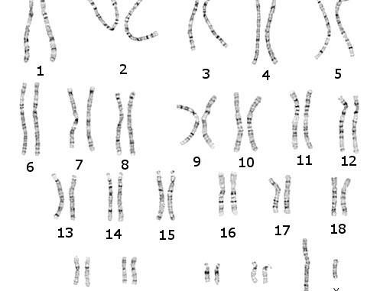
Problem 1. Needle in a haystack and contributory value in large datasets
Finding unique genes and their functions in a small % of genome

Slide 9

Problem 2. Gene Flow
Pollen, Seeds, Birds, Fish, and Genes Migrate
IPLC Territory
+ Associated TK

Slide 10
Problem 3. Phylogeny / Shared Genes
All beings related – sequences widely shared
98.7% bonobos
Moving from biological samples to the
  genetic level presents challenges to
  ownership claims
Ownership would be related to
  “unique” genes and sequences
Unique G&S only identifiable
  following sequencing
80% bears
60% salmon
40% insects
24% wine grapes

Slide 11
Problem 5. Intellectual Property Systems
Certain genetic sequences have likely been modified / selected by IPLCs (Nagoya Protocol)
If sequences are unique and on IP or LC territories or areas, this falls under Nagoya (only derivable from localizable samples)
Many jurisdictions do not recognize property in
“unmodified” or “wild” genes
Require non-obviousness and creative modification
Patents often not on genes but innovations in molecules or technologies to produce them

Slide 12
Global Multilateral Benefit-Sharing Mechanism GMLBSM
Deposit Requirements
[origin]
Hybrid Approach
Nagoya
FPIC & MAT
Access requirements
[license,
ethics]
Funds distributed as projects
F&E IPLC Participation in Governance
Fair distribution
of projects
New genetic materials acquired from Indigenous territories or collections form these lands under Nagoya
Triggers
following digitalization
Raising funds from research
1% on commercial sales of products using DSI
endemic
species
genes
Non-monetary Benefits

Slide 13
Cali Fund
15/9. Digital sequence information on genetic resources
CBD/COP/DEC/15/9
16/2. Compilation of draft decisions for the sixteenth meeting of the Conference of the Parties to the Convention on Biological Diversity
CBD/COP/16/2
Item 9. Digital sequence information on genetic resources

Slide 14
Cali Fund
Establishes two bodies: Each with reps from 7 sociocultural regions (Apps: 14 March)
Steering Committee
Overall governance
Databases: governance. Lost direct ref to biocultural metadata.
Nagoya Protocol and National ABS system linkages
Ad Hoc Technical Advisory Group (AHTEG) on Allocation (Apps: 4 April 2025)
Issues related to the disbursement of funds from the Cali fund
Monetary benefit sharing (MBS) and non-monetary benefit sharing (NMBS)

Slide 15
Cali Fund
Establishes a floor for funding: At least 50% (dedicated funding).
States get 50%, but some will likely distribute to IPs and LCs
Direct funding to IPs and LCs. Details still need to be worked out.
IIFB WG on Resource Mobilization working on brief description on what
direct funding means. Decision refers to “self-identified institutions” of
Indigenous Peoples and local communities.
Based on voluntary donations: We do not know overall level of funds that will be raised. Ambitions are in the hundreds of millions.

